Slide 1
Real time License plate Recognizer using Raspberry pi. (PHASE 3)
Sujay Suryavanshi (4nm18cs192)
Sreehari Rajendra Kumar (4nm18cs187)
Suraj Naik (4nm18cs196)
Vishnu AC (4nm18cs214)

Slide 2
MAPPING OF FUNCTIONALITY TO WORKING
detecting a vehicle using IR sensor. if GPIO.input(sensor): print "running recognition code“
Capturing image of the number plate. Using pi cam camera.capture(rawCapture, format="bgr")
image = rawCapture.array
Validating the input using ml.
Opening or closing the gate once validation is completes by rotating the motor.
if (result = “open”)
{
GPIO.output(Motor1A,GPIO.HIGH);
time.sleep(20)
}
else
{
//remain closed;
}

Slide 3
RESULTS EXPECTED FROM EACH MODULES
MODULE 1: setting up system to detect vehicle using sensor and capturing of image ( number plate ) using picam.
expected : true when vehicle is detected and capture an image
MODULE 2: writing a program to validate the number on the number plate and store the data.
expected: number plate details in text form.
MODULE 3: programming the system to perform corresponding actions based on the results obtained by module 2.
expected: the gates to open or remain closed.
MODULE 4 : setting up a web application to access the stored data.
expected: a web application to view the saved images.

Slide 4
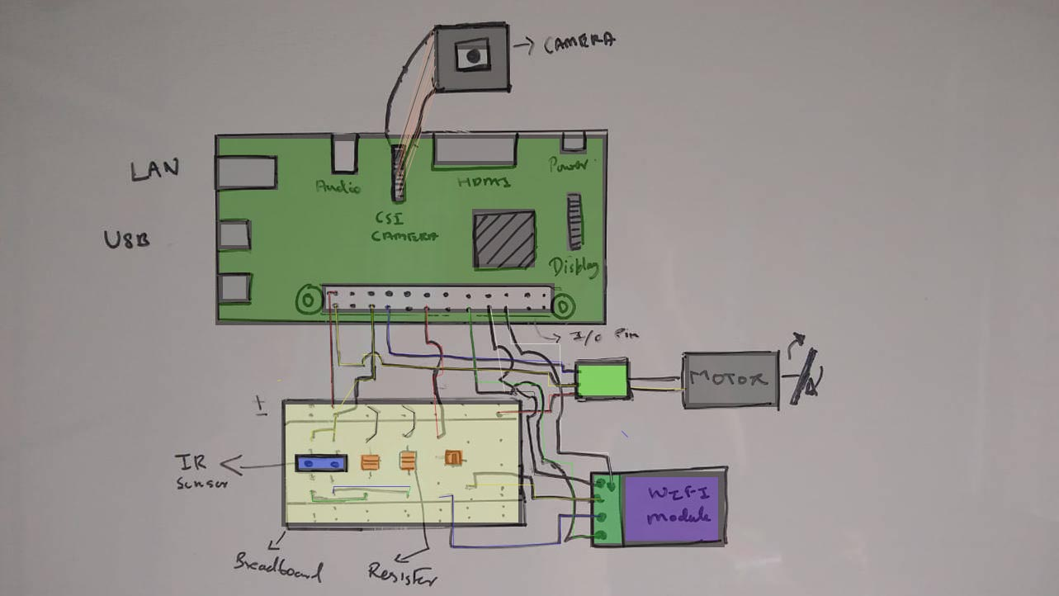
CIRCUIT DIAGRAM

Slide 5
THANK YOU

